Slide 1
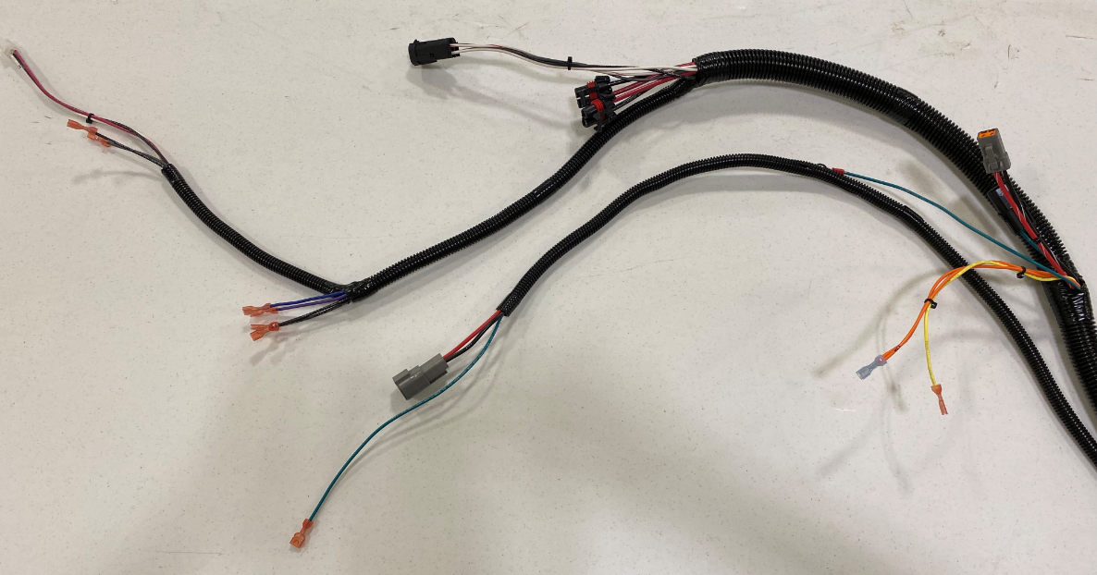
Frame/Head/Head Lift/Vac
Head Lift Actuator
Right/Left Brush Motors
TDS Board
Transaxle
High Pressure Microswitch
Transaxle Ground
Low/Med Pressure Microswitch
Vac Motor
Squeegee Lift Switch
Vac Motor Ground

Slide 2
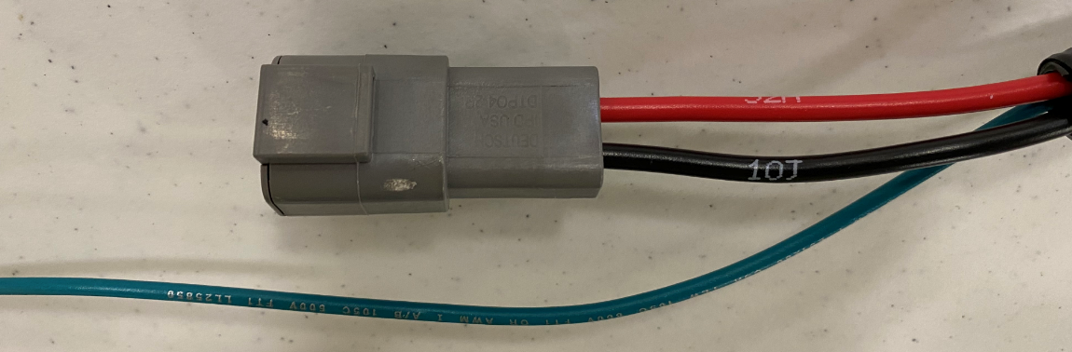
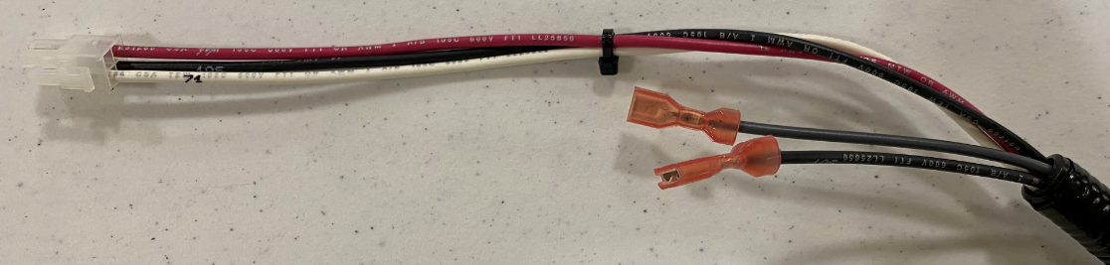
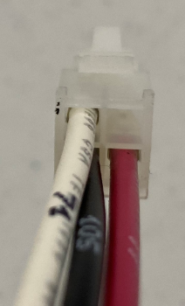
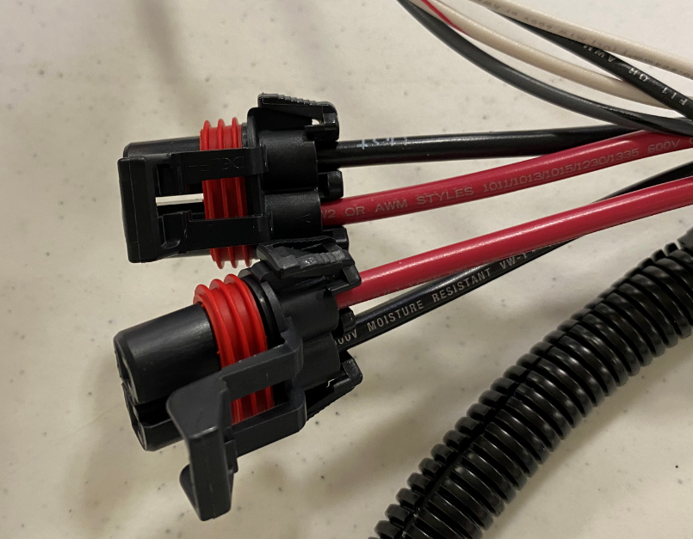
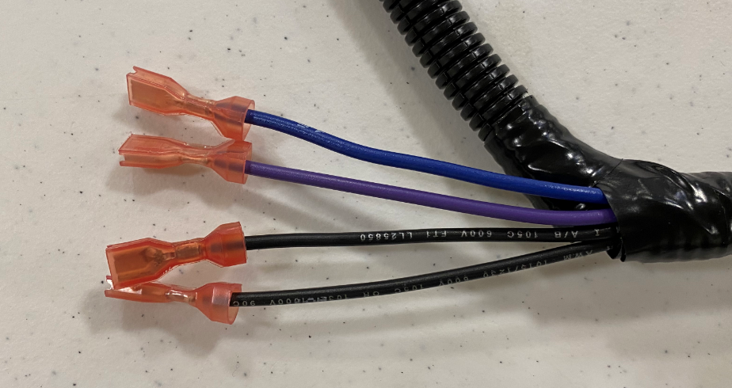
Frame/Head/Head Lift/Vac
Vac Motor
TDS Board
4 pin
Red – 32A
Black – 10J
Vac Motor Ground
Green - 64
Tab
High Pressure – Grey – 18
Black – 10S
Pin 1 – Red – 77
Pin 2 – Black – 10S
Pin 3 – Open
Pin 4 – White - 71
Left Brush
Red – 12A
Black – 10H
Low Pressure – Blue – 16
Medium Pressure – Purple - 17
Black -10M
Black – 10E
Right Brush
Red – 22A
Black – 10I

Slide 3
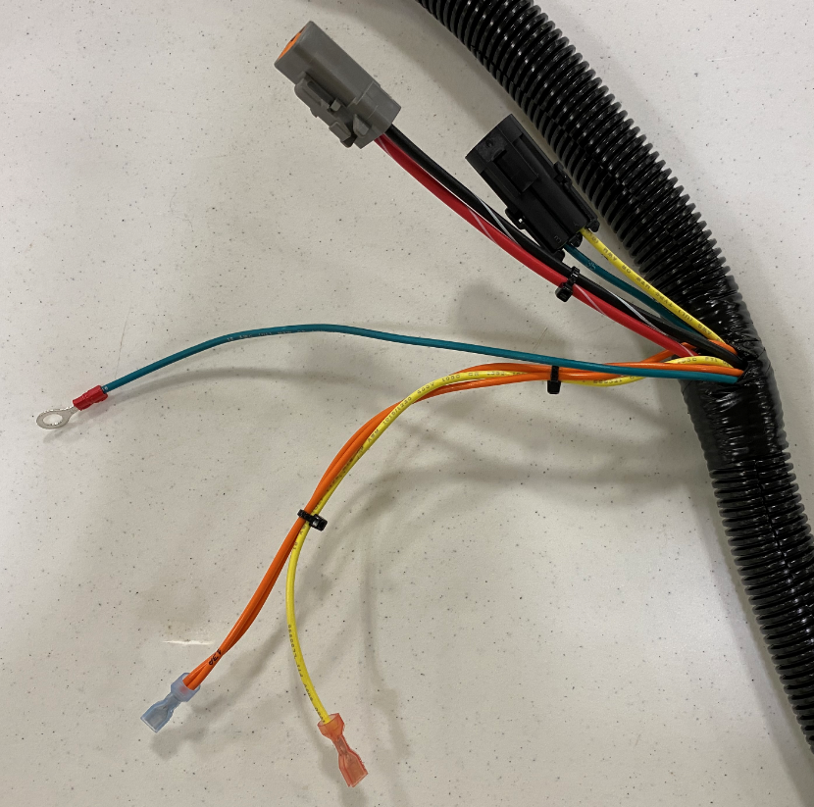
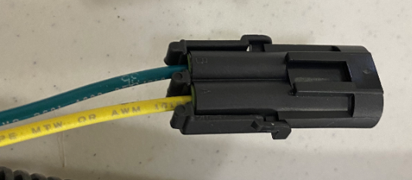
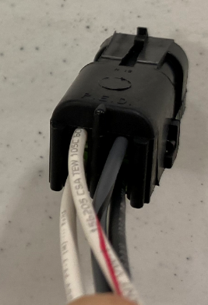
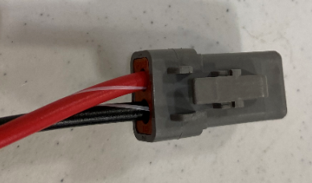
Frame/Head/Head Lift/Vac
Transaxle Ground – Green - 64
Pump
Yellow – 4B
Green - 35
Squeegee Switch
Yellow – 14
Orange – 13 & 13A
Actuator
Pin B – White/Red - 39
Pin A – Gray/Black - 38
Transaxle
Red – 52
Black - 70
Pin C – White - 19
Pin D – Black – 10Q

Slide 4
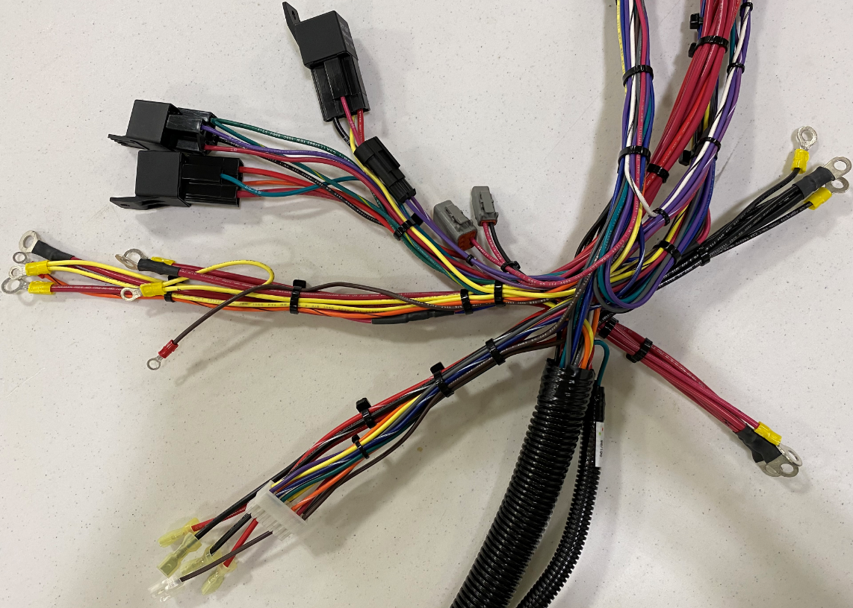
Inner Electrical Panel
Relays
Charger Interlock
Watering Kit
Negative Terminals
To Motor Contactors
Positive Terminals
To I-Drive

Slide 5
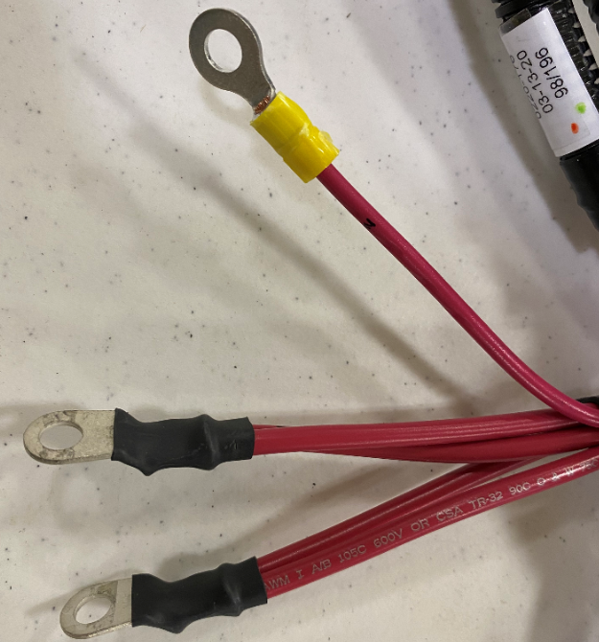
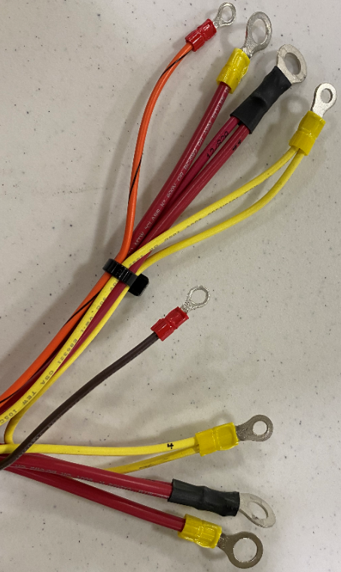
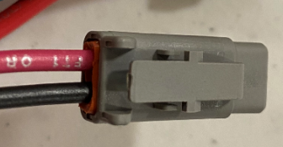
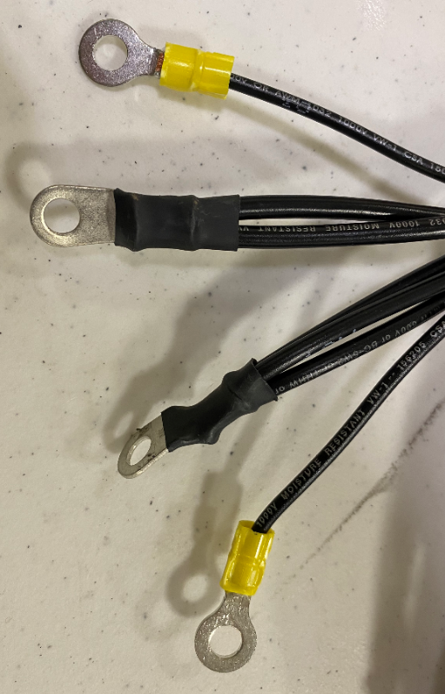
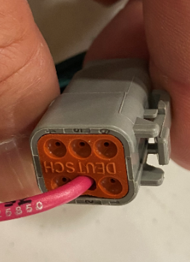
Inner Electrical Panel
Left Brush Contactor
Orange - 33
Double Yellow – 4A & 4B
Red – 2E
Double Red – 12 & 12/82A
Positive Standoff
Single Red – 2
Double Red – 2G & 2I
Double Red – 2E & 2F
Watering Kit
Red – 2J
Black – 10F
Watering Kit
Pin 2 - Red – 92
Right Brush Contactor
Brown - 31
Red – 2F
Double Yellow – 4 & 4A
Double Red – 22 & 22/82
Negative Standoff
Single Black – 10
Single Black - 10
Double Black – 10I & 10H
Triple Black – 10D, 10J, & 10N

Slide 6
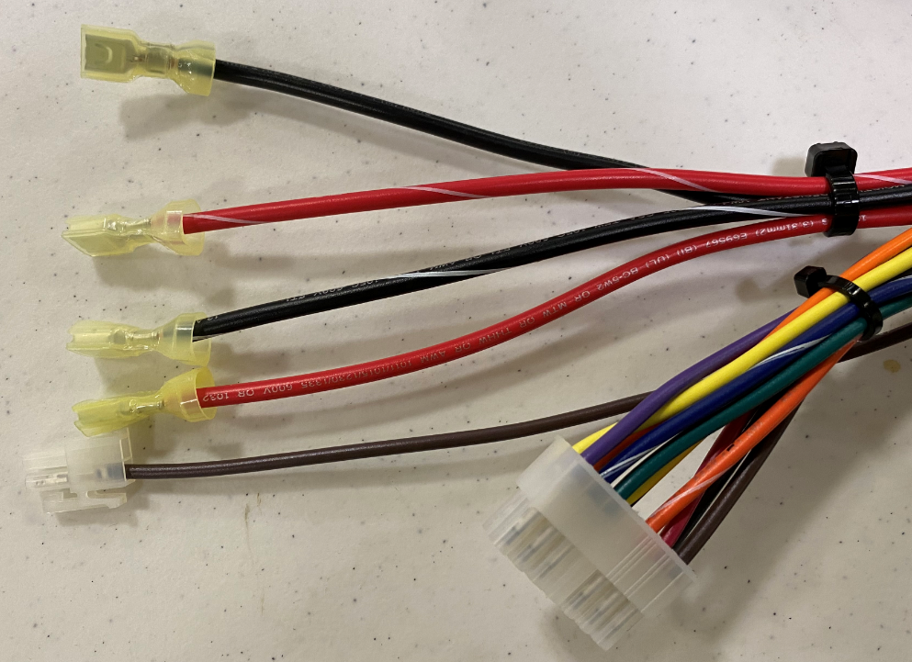
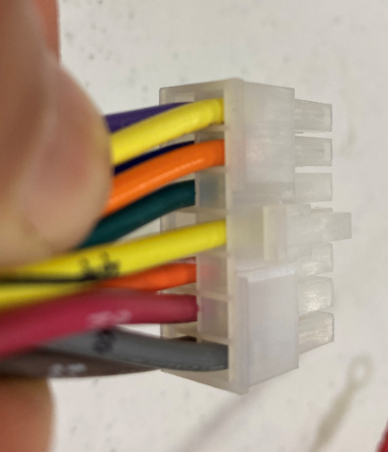
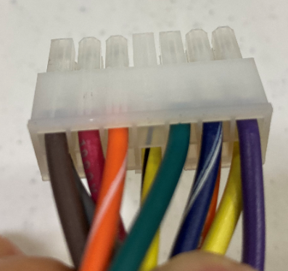
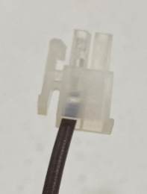
Inner Electrical Panel
I-Drive Connections
14 pin connector (top)
Black – 10D
Red/White Stripe – 52
Black/White Stripe – 70
Pin 8 – Grey – 8
Pin 9 – Open
Pin 10 – Open
Pin 11 – Yellow/Black Stripe – 44
Pin 12 – Open
Pin 13 – Orange – 13
Pin 14 – Yellow – 14
Red – 42
14 pin connector (Bottom)
I Drive – 2 pin
Pin 1 – Not Used
Pin 2 – Brown - 11
Pin 1 – Brown – 21
Pin 2 – Red – 62
Pin 3 – Orange/White Stripe - 3
Pin 4 – Open
Pin 5 – Green – 5
Pin 6 – Blue/White Stripe – 6
Pin 7- Purple - 7

Slide 7
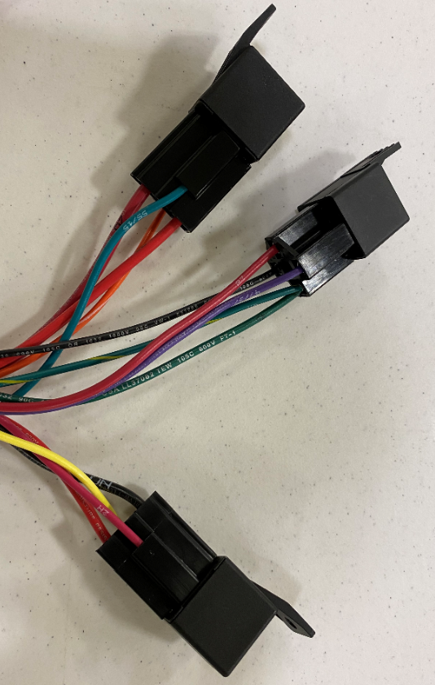
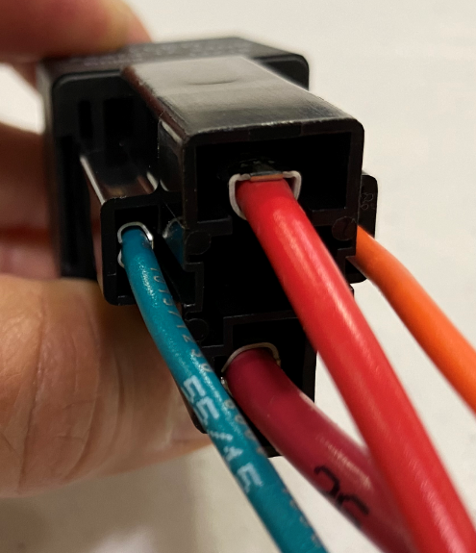
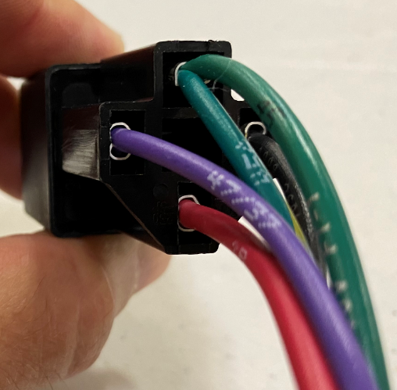
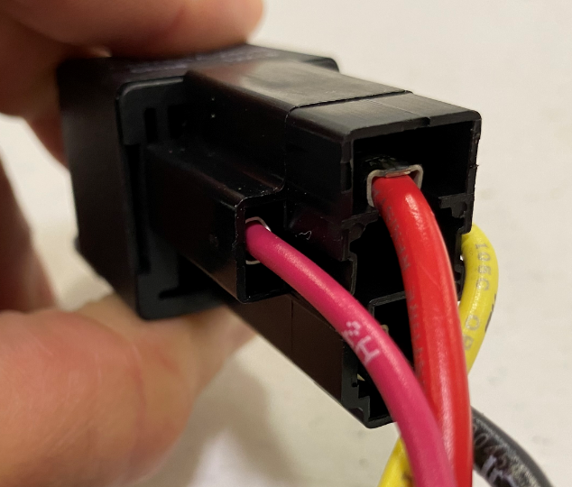
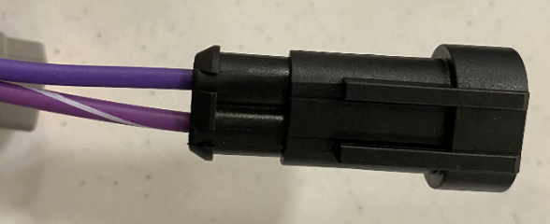
Inner Electrical Panel
Vac Relay
Controller Relay
Terminal 86 – Teal – 55/15
Terminal 87 – Red – 32
Terminal 86 – Purple – 47/37
Terminal 87 – Green – 45/45A
Vac Relay
Terminal 85 – Black – 10G
Controller Relay
Terminal 30 – Red – 2B
Terminal 30 – Red – 2G
Terminal 85 – Orange – 3
Auto Pad Relay
Terminal 86 – Red – 2H
Terminal 87 – Red – 82/82A
Auto Pad Relay
Charger Interlock
Pin 1 – Purple/White Stripe – 57
Pin 2 – Purple - 7
Terminal 85 – Yellow – 34
Terminal 30 – Black – 10N

Slide 8
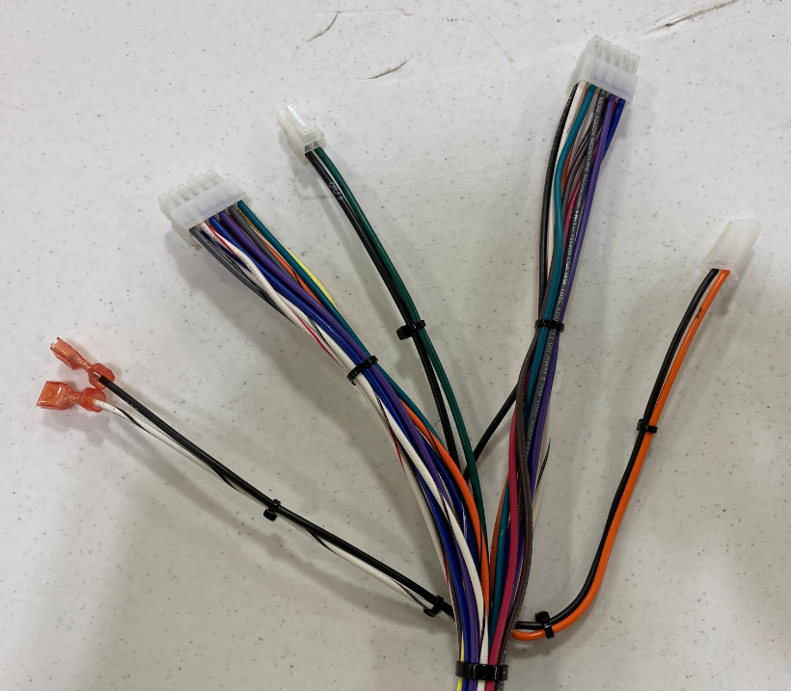
Outer Electrical Panel
Control Board 10-pin
Control Board 4-pin
Control Board 12-pin
Solution Potentiometer
Auto Pad Release

Slide 9
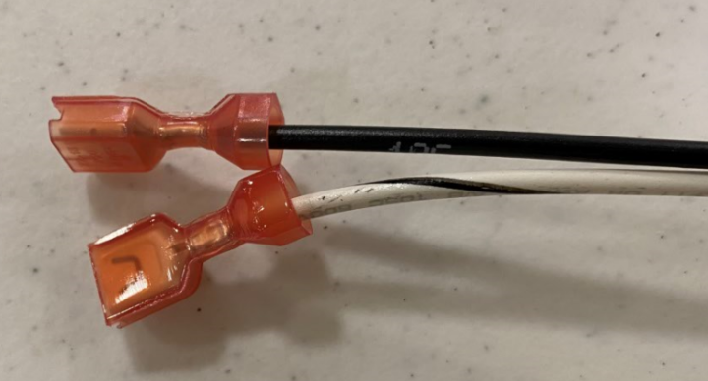
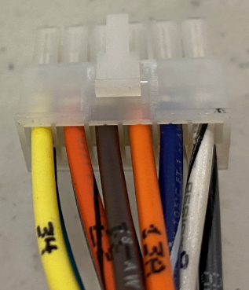
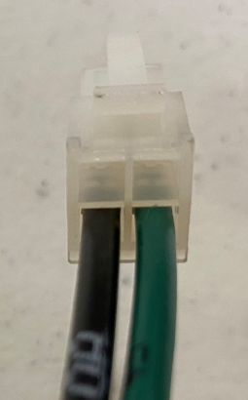
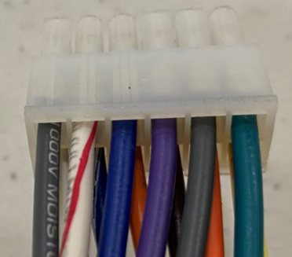
Outer Electrical Panel
12 pin connector (top)
Pin 7 – White/Black Stripe – 9
Pin 8 – Blue/White Stripe – 6
Pin 9 – Orange – 13A
Pin 10 – Brown - 31
Pin 11 – Orange/Black Stripe - 33
Pin 12 – Yellow - 34
Auto Pad Release
Black – 10C
White/Black Stripe - 29
Control Board 4-pin
Pin 1 – Green – 45
Pin 2 – Black 10A
Pin 3 – Open
Pin 4 - Open
12 pin connector (bottom)
Pin 1 – Grey/Black Stripe – 38
Pin 2 – White/Red Stripe – 39
Pin 3 – Blue - 16
Pin 4 – Purple - 17
Pin 5 – Grey - 18
Pin 6 – Green - 35

Slide 10
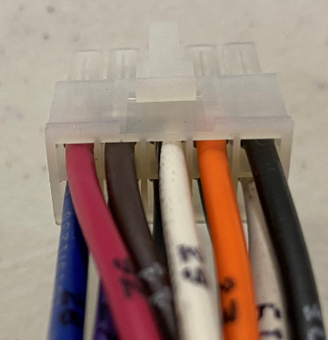
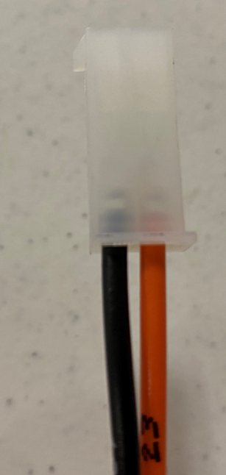
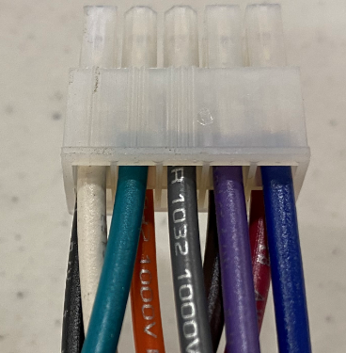
Outer Electrical Panel
10 pin connector (top)
Pin 6 – Black – 10K
Pin 7 – Orange – 23
Pin 8 – White/Black Stripe – 29
Pin 9 – Brown - 11
Pin 10 – Red - 92
Solution Potentiometer
Pin 1 – Orange - 23
Pin 2 – Black – 10R
10 pin connector (bottom)
Pin 1 – White – 19
Pin 2 – Green – 25
Pin 3 – Grey - 228
Pin 4 – Purple - 27
Pin 5 – Blue - 26

Slide 11
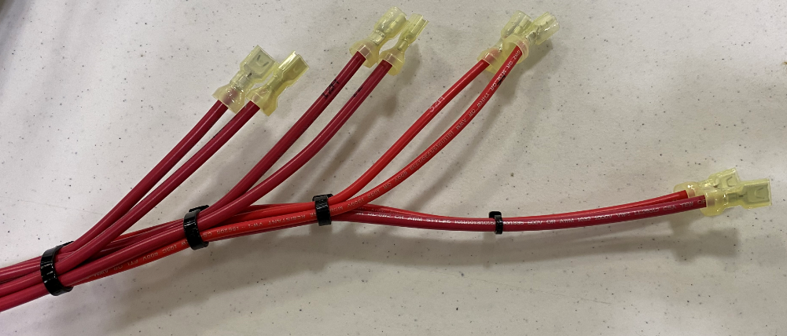
Outer Electrical Panel
Left Brush – 12 & 12A
Right Brush – 22 & 22A
Vac Motor – 32 & 32A
I-Drive – 2I & 42
Circuit Breakers

Slide 12
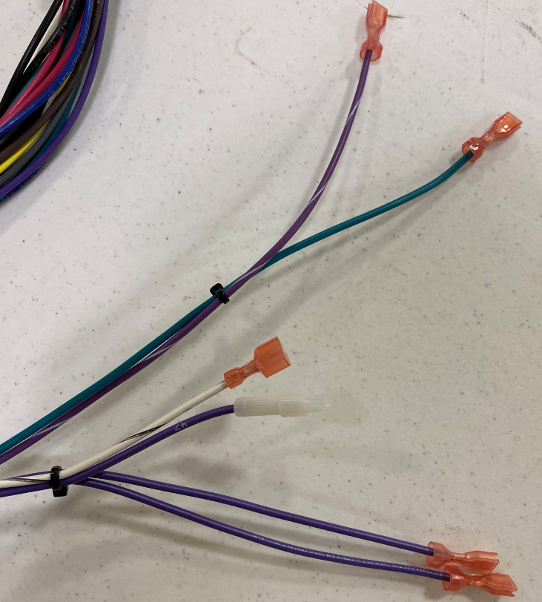
Outer Electrical Panel
TDS Disable
Purple – 65 & 65A
Key Switch
Green – 5/15/57
Purple/White Stripe - 57
Battery Water LED
Purple – 47
White/Black Stripe - 9

Slide 13
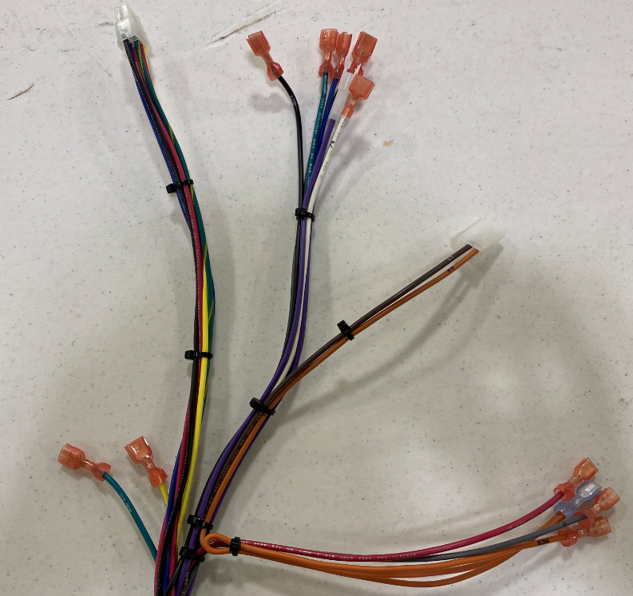
Handle Console
Standard Hour Meter
BT Hour Meter
Rotary Down Pressure Switch
SoliChem LED
Speed Potentiometer – 3 pin
Forward/Reverse Switches

Slide 14
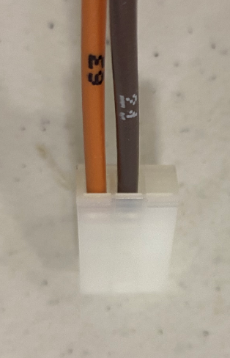
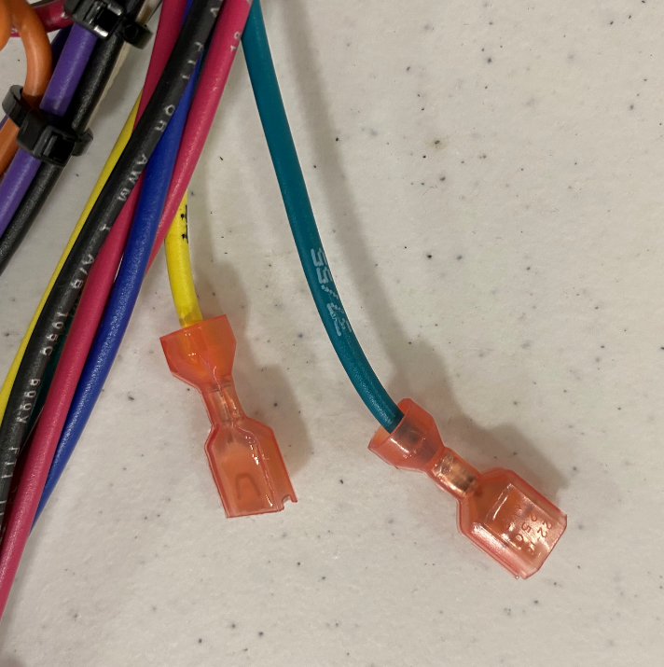
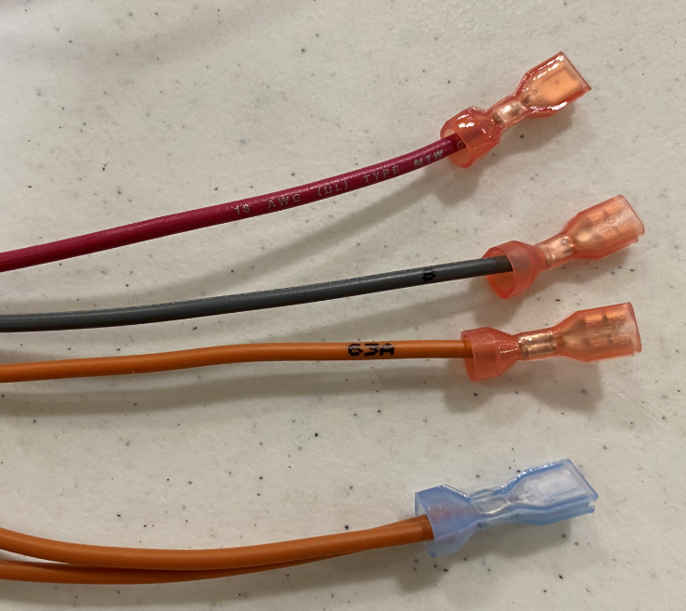
Handle Console
BT BDI
Green – 37/55
Yellow - 44
Speed Potentiometer 3-pin
Pin 1 – Open
Pin 2 – Brown – 21
Pin 3 – Orange - 63
Forward/Reverse Switches
Red – 62
Grey – 8
Single Orange – 63A
Double Orange – 63 & 63A

Slide 15
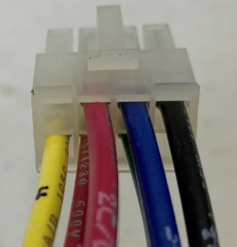
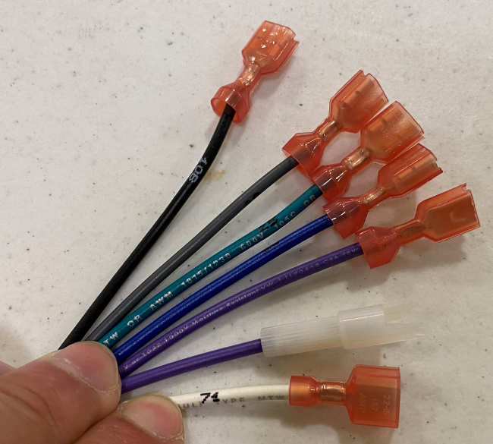
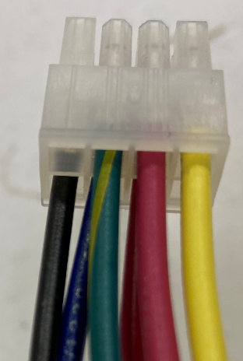
Handle Console
BDI 8-pin Connector (top)
Rotary Down Pressure Switches
Black – 10B
Grey – 28
Green – 25
Blue – 26
Purple - 27
Pin 5 – Black – 10F
Pin 6 – Blue - 36
Pin 7 – Red – 2C/D
Pin 8 – Open
SoliChem LED
Purple – 65A
White - 71
BDI 8-pin Connector (bottom)
Pin 1 – Open
Pin 2 – Green/Yellow Stripe – 45A
Pin 3 – Red – 2C/D
Pin 4 – Yellow - 4

